Slide 1
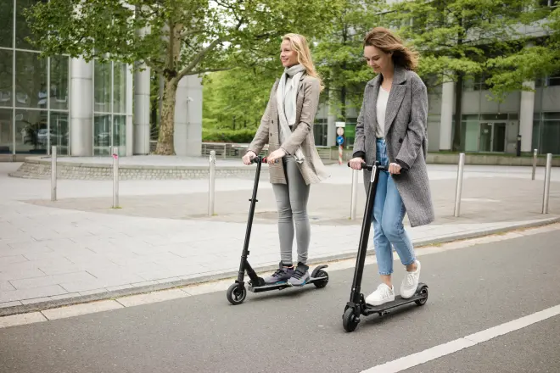
What is the law around electric scooters?
Challenge: what do you think the law should be? Why?

Slide 2
What is the law around electric scooters?
Watch and read carefully! (video in folder T:\HoY\Scooters)

Slide 3
FAQs
What is the law around electric scooters?

Slide 4
We support the law, and urge you not to use an e-scooter. From Tuesday May 3rd, electric scooters will not be allowed on school site.
Electric scooters and school

Slide 5
A study commissioned by Transport for London (TfL) indicates that riding an e-scooter could be 100 times more dangerous than riding a bicycle
Traumatic head injuries and fractures to the jaw, wrists and ankles are not uncommon, and there have been fatalities of riders and unfortunate pedestrians. Small children seem to be especially vulnerable to injury as they pass by
Safety FYI

